Slide 1
Sorting Based on 4N and 8N Ploidy
A.
B.
Vybrant DyeCycle Green
Figure 1. Sorting hepatocytes based on ploidy. (A) NPCs were excluded from hepatocyte gating based on their lower FSC and BSC. (B) Each Vybrant DyeCycle Green peak indicates a population with a different ploidy based on DNA content. The 4N and 8N peaks were sorted to evaluate any difference in outgrowth and organoid formation.

Slide 2
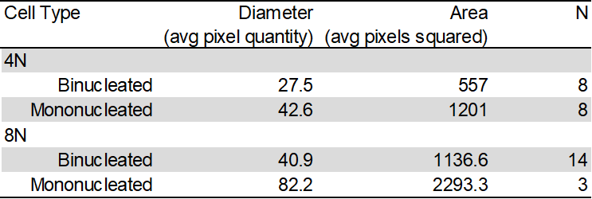
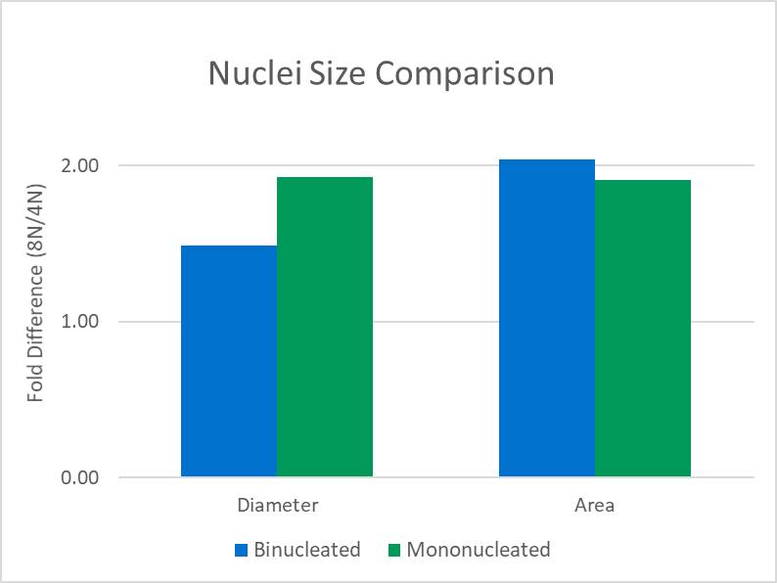
Hepatocyte Nuclei Measurements Indicate Accurate WOLF Sorting
A.
4N - DAPI Vybrant DyeCycle Green Membrane
B.
Figure 2 Results:
After a two-way sort for 4N and 8N nucleated cells, cells were stained with DAPI and imaged at 40x to determine nuclear diameter and area.
Binucleated and mononucleated cell nuclei are different sizes so they were compared separately.
8N nuclei were generally two-fold larger than 4N, indicating a ploidy with twice as many chromosomes.
Conclusion:
Post-sort ploidy revealed that the 8N hepatocyte nuclear diameters and areas were generally two-folder larger than the 4N hepatocytes. This confirms that the WOLF properly sorted and separated 4N and 8N cells Though the lower fold-difference in binucleated average diameter suggests impure 8N-sorted cells, the two-fold difference in area suggests this may be due to manual measurement error instead of sorting impurity.
C.
8N - DAPI Vybrant DyeCycle Green Membrane

Slide 3
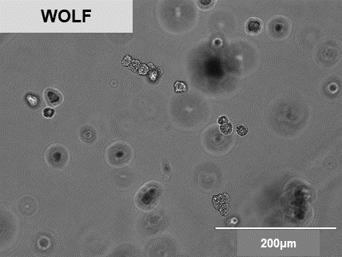
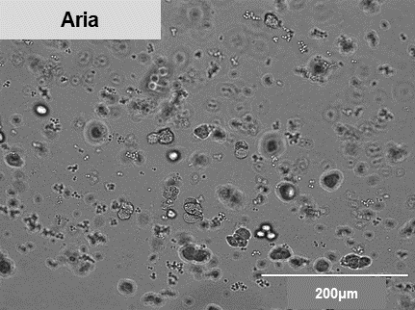
WOLF Workflow Maintains Sterility
Figure 3 Results: WOLF cells remained healthy and sterile (Left), while those sorted by the BD FACSAria II developed a yeast infection at Passage 0 (Right). Since all other conditions were shared, contamination was most likely introduced by the BD sorter.
Conclusion: The WOLF may have avoided contamination because it uses a disposable cartridge and tubing set, so its fluidics were new and sterile. Another possibility is that the contamination came from the open air during the sort, which could also be avoided with the WOLF - it fits into a biosafety cabinet with HEPA-filtered air.

Slide 4
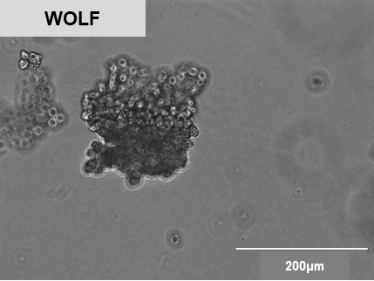
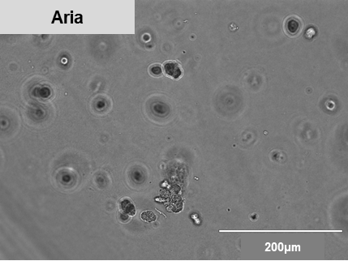
WOLF Sort Results in Organoid Formation
Figure 4 Results: Only cells sorted by the WOLF (Left) formed 3D organoids at Passage 0, while those sorted by the BD FACSAria II (Right) were still in single cell formation.
Conclusion: The BD FACSAria II sorted cells may be sparse and lack organoid formation due to multiple instrument factors that affect viability: higher sorting pressures (20-70 psi), shear forces applied when passed through the sorting nozzle, and decompression shock experienced after exiting the system. The WOLF may have better outgrowth due to its low pressure (<2 psi) sorting mechanism, low shear stress laminar flow, and lack of decompression shock.

Slide 5
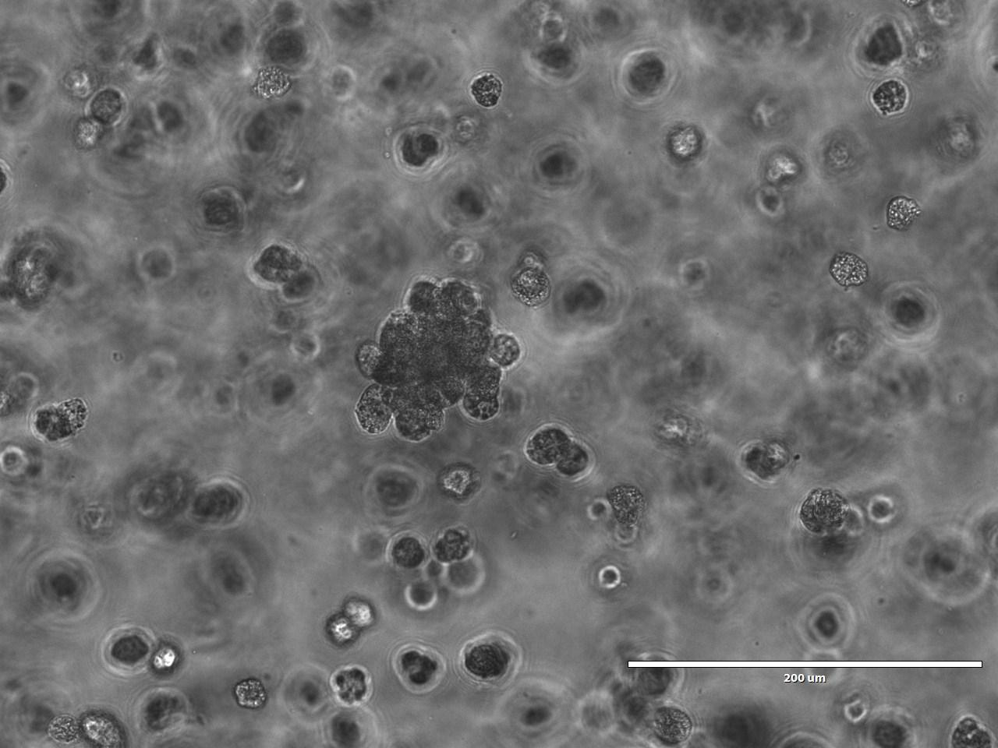
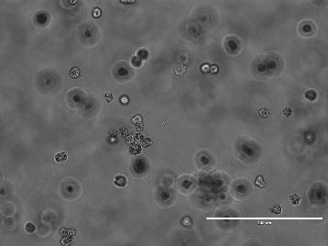
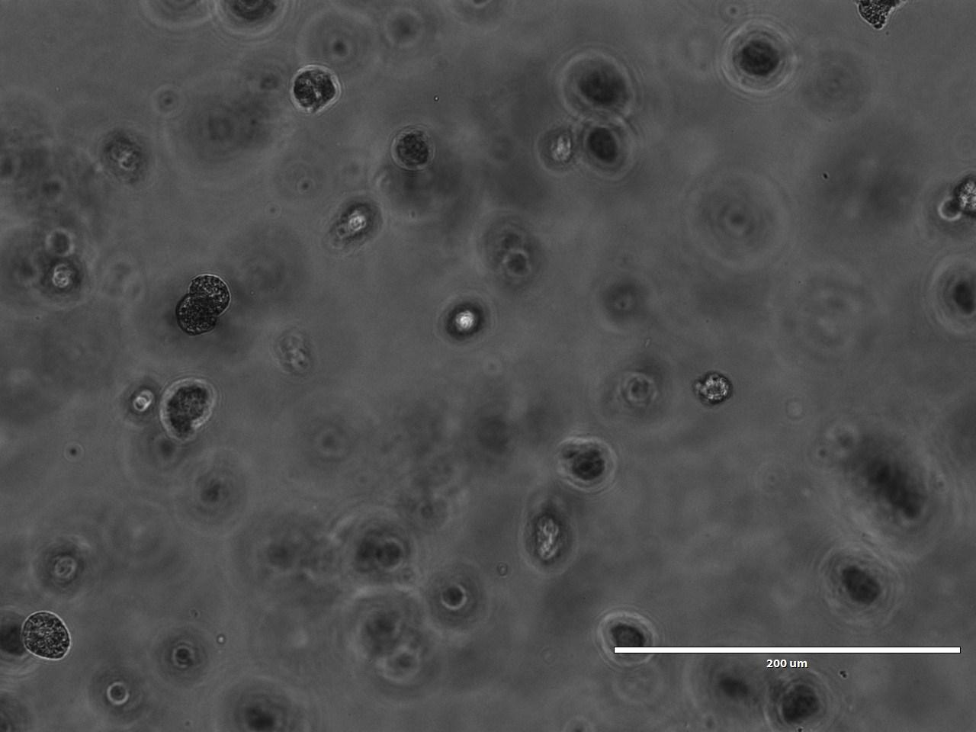
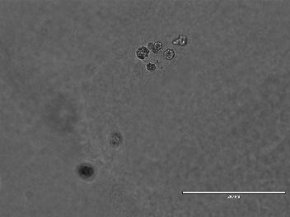
4N Cells Yield Better Proliferation than 8N
A.
4N – Passage 0
4N – Passage 1
200μm
200μm
B.
8N – Passage 0
8N – Passage 1
200μm
200μm
Figure 5. 4N proliferates better than 8N after first passage. (A) 4N hepatocytes demonstrate the expected ‘grape-like’ structure after sorting and continue to proliferate after the first passage. (B) 8N hepatocytes remain in single cell clusters after sorting and demonstrate much lower confluency than the 4N cultures.

