Slide 1
10x Genomics Unsorted/Aria/WOLF:
Cells: Dissociated primary mouse prostate cells from 2 month old FVB WT mice
3 independent experiments done on different days
3-5 mice per experiment
Sorted for PI- Calcein + live cells
Notes:
FVB- albino inbred mouse strain, suspectible to Friend Leukemia Virus B

Slide 2
Figure 1
BD FACSAria II Sort Gates
Live Cells 65.4%
Single Cells 87.7%
Single Cells 2 91.8%
SSC-A
SSC-H
FSC-H
PI
Cells 92.6%
FSC-A
SSC-W
FSC-W
Calcein
WOLF Sort Gates
BSC-H
FSC-H
PI
Cells 76.3%
Single Cells 85.4%
Live Cells 67.3%
FSC-H
FSC-A
Calcein

Slide 3
Figure 2
A.
B.
C.
D.

Slide 4
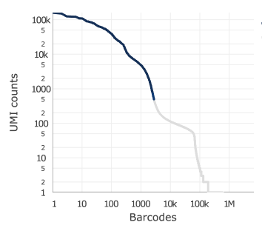
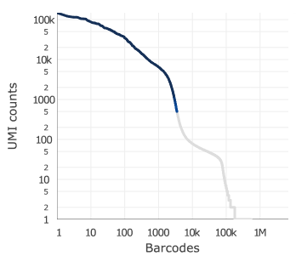
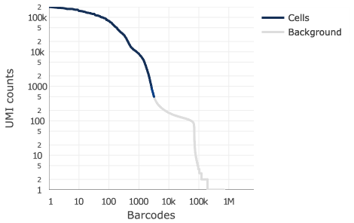
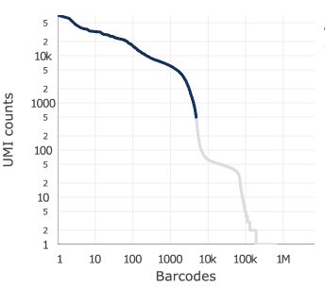
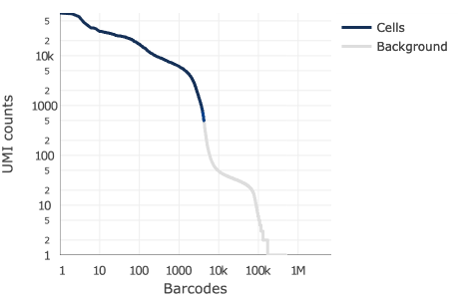
Figure 3
Cells
Background
Unsorted
Cells
Background
BD FACSAria II
Cells
Background
WOLF

